Slide 1
NFS Distributed File Based System
Upadhyay Shreyans Indresh
Roll No. 18
MSc IT Part 1

Slide 2
Table of Content
Distributed File System
Network File System
Architecture of NFS
NFS Version
Naming in NFS
Communication in NFS
Synchronization in NFS
Fault Tolerance in NFS
Security
Consistency and Replication

Slide 3
Distributed File System
Distributed File System is a set of client and
server services that allow an organization
using Microsoft Windows servers to organize
many distributed SMB file shares into a
distributed file system.
The main purpose of DFS is to allow
users of physically distributed system to
share their data and resources by using a common file system.
DFS has two components
Location Transparency- achieves through the namespace component.
Redundancy-It is done through a file replication component.

Slide 4
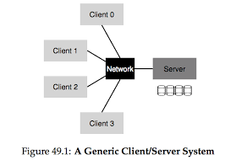
Network File System (NFS)
Network File System (NFS) is a distributed file
system protocol originally developed by
Sun Microsystems (Sun) in 1984.
NFS allows a user on a client computer to
access file over a computer network much like
local storage is accessed.
Like many other protocols, NFS builds on the
Open Network Computing Remote Procedure
Call (ONC RPC) system.
NFS is an open standard defined in a Request For Comments (RFC) allowing anyone to implement the protocol.

Slide 5
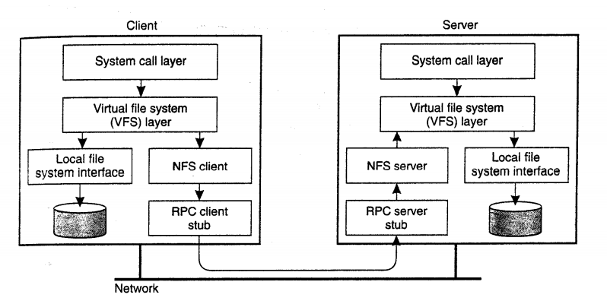
Architecture of Network File System (NFS)
VFS to handle local and remote files common interface.
RPC for data transport.

Slide 6
NFS Version
NFSv1
Developed in-house experimental purpose.
NFSv2 (March 1989)
operated only over User Datagram Protocol (UDP).
Release for commercial use.
NFSv3 (June 1995)
Overcome to version 2
Support for asynchronous write on server
V3 obtains multiple file names
Support 64-bit file size and offset
Improve performance and allowed it to work more reliably across the internet

Slide 7
NFSv4 (2003)
Overcome to v2 and v3
Stateful server
Use TCP
Focus on performance, accessibility, strong security and extensibility
Developed with IETF (Internet engineering Task Force)
NFS version 4.1 (January 2010) aims to perform scalable parallel access to files distributed among multiple server.
NFS version 4.2 is currently being developed

Slide 8
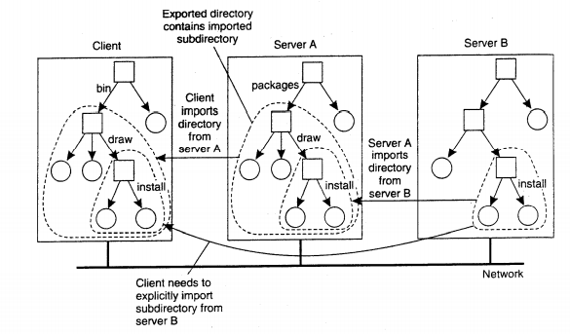
Naming in Network File System
The fundamental idea underlying the NFS naming model is to provide clients complete transparent access to a remote file system as maintained by a server.
NFS provide support for mounting remote file systems into client’s local namespace.
Instead of mounting an entire file system, NFS allows clients to mount only a part of file system.
A server is said to export the directory when it makes that directory and its entries available to clients.
Fig. Mounting nested
directories from multiple
servers in NFS

Slide 9
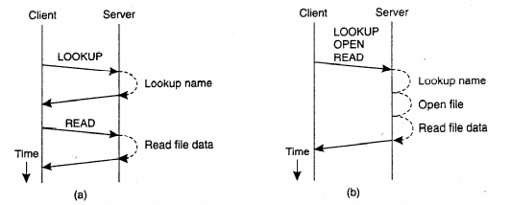
Communication in NFS
All communication between a client and server proceeds along the Open Network Computing RPC (ONC RPC) protocol.
Every NFS operation can be implemented as a single remote procedure call to a file server.
In NFSv4, the client was made responsible for making the server's life as easy as possible by keeping requests relatively simple.
Fig: a. Reading data from a file in nfs v3 b. Reading data using a compound procedure in v4

Slide 10
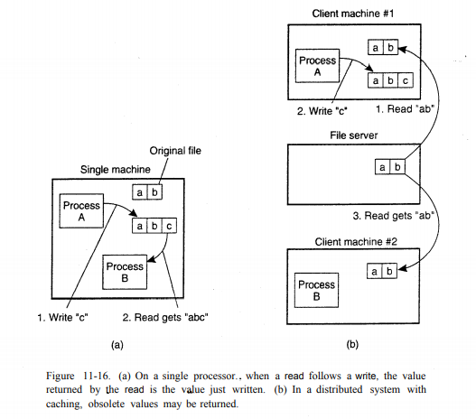
Synchronization in NFS
When two or more users share the same file at
the same time, it is necessary to define the
semantics of reading and writing precisely to
avoid problems. In single processor system that
permit processes to share files, such as UNIX, the
semantic normally state that when a read
operation follows a write operation, the read
returns the value just return.
When two writes happen in a quick succession,
followed by a read, the value read is the value
stored in the last write.

Slide 11
Synchronization in NFS
Operation | Description
Lock | Create a lock for a range of bytes
Lockt | Test whether a conflicting lock has been granted
Locku | Remove a lock from a range of bytes
Renew | Renew the lease on a specified lock

Slide 12
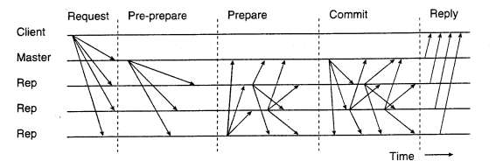
Fault Tolerance
Byzantine Failure
Nodes/components fails arbitrarily
Perform incorrect result
Give conflicting information to
different parts of system
Collude with other failed nodes
fig different phases in byzantine fault tolerance

Slide 13
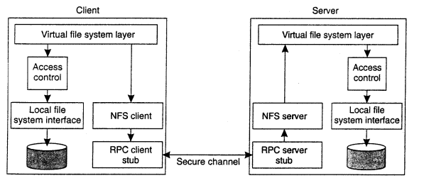
Security in NFS
Security in NFS mainly focus on the
communication between a client and
a server.

Slide 14
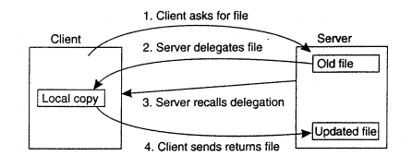
Consistency and Replication in NFS
Caching and replication play an important role in distributed file systems, most notably when they are designed to operate over wide-area networks.
Caching in NFS
Fig NFSv4 callback mechanism to recall file delegation

Slide 15
Advantages, Disadvantage and Conclusion
Stateless server and client
Server can be rebooted and user on client might be unaware of the reboot
Client/server distinction occurs at the application not at the system level
Highly flexible
Uses RPC authentication, easily spoofed
File system data is transmitted in clear text
Network slower than local disk
New technologies open up new possibilities for NFS

Slide 16
Thank You

